Slide 1
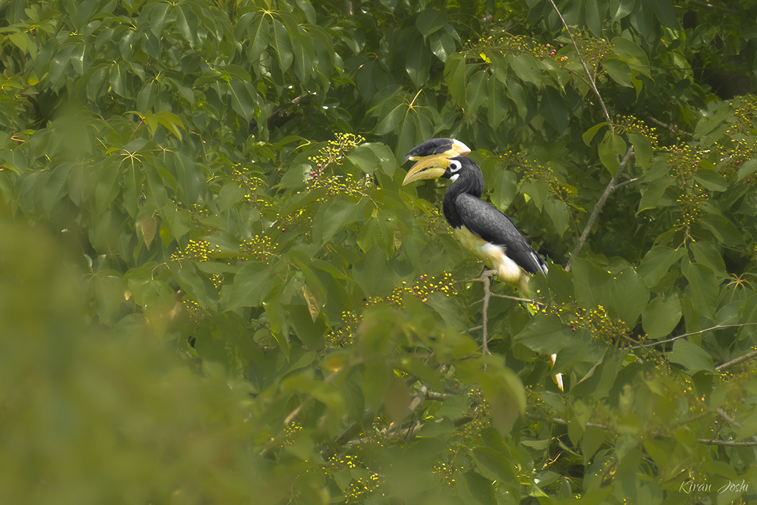
Corporate Birding Retreats in India
Corporate Birding Retreats in India: Team Building in the Wild
Nature-based corporate experiences
Presented By :- The Lens India.

Slide 2
What are Corporate Birding Retreats?
Birding is a powerful team-building tool that enhances key leadership skills like focus,
coordination, and decision-making.
Wildlife-based corporate retreats – Curated by The Lens India
Guided bird watching + team activities – Expert-led experiences for team engagement
Learning through real-world experiences – Hands-on learning
Strategic Positioning –
Planning & positioning skills
Environmental Awareness –
Understanding ecosystems

Slide 3

Skills Developed Through Birding
Observation & Attention to Detail – Enhanced through corporate birding retreats in India by the lens India, improving the ability to notice small details
Patience & Focus – Developed during guided birding sessions conducted by the lens India
Silent Coordination – Strengthened through team-based activities in corporate birding retreats in India
Strategic Thinking – Built through real-time decision-making in natural environments curated by the lens India
Environmental Awareness – Improved by immersive experiences in corporate birding retreats in India

Slide 4
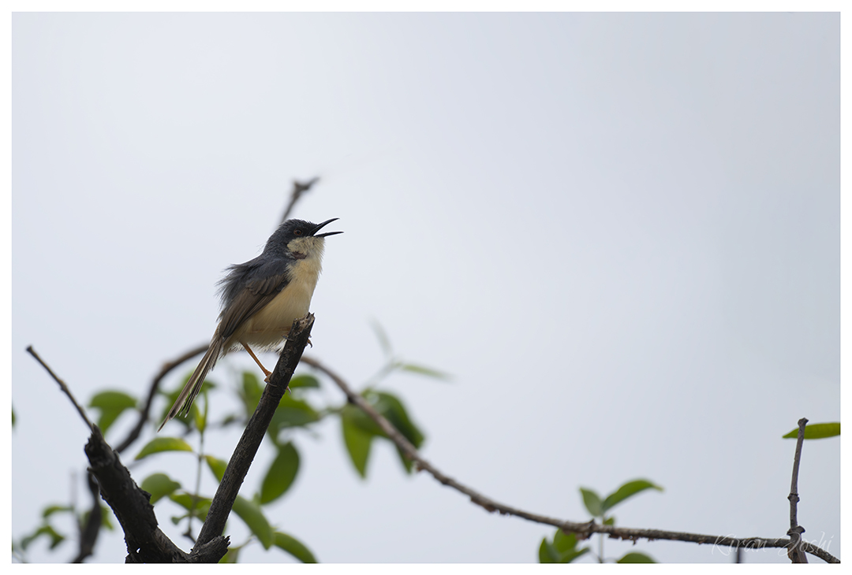
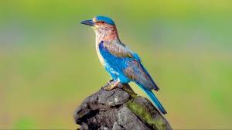
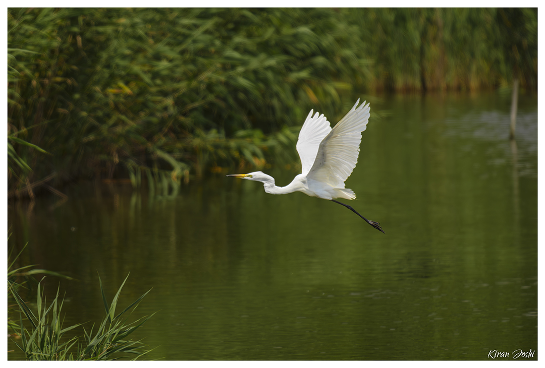
Ideal Destinations
Top Locations in India
These biodiversity-rich locations are frequently included in Corporate Birding Retreats in India organized by The Lens India:
Western Ghats
Dandeli, Karnataka
Maharashtra Wetlands
Locations: Maharashtra & Karnataka
Hornbill habitat, guided forest trails, riverine bird species in pristine natural settings
Locations: Bhigwan & Surroundings
Endemic bird species, rainforest ecosystems, scenic landscapes accessible from major cities
Migratory birds, open landscapes ideal for sunrise observation session

Slide 5

Structure of a Typical Retreat
1
Day 1 – Arrival & Orientation
Learn birding fundamentals, reflect on leadership skills, and enjoy an evening nature walk with The Corporate Bird team
2
Day 2 – Field Birding Experience
Explore natural habitats with expert guides from The Lens India, identify birds, and learn about ecosystems.
3
Day 3 – Reflection & Strategy
Lessons from nature, applying field insights to corporate roles, closing circle discussion

Slide 6
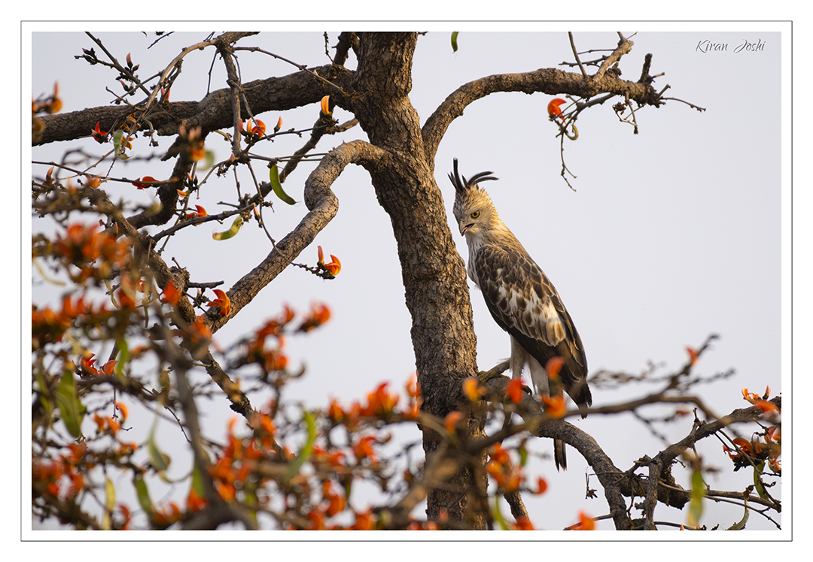
Leadership Lessons from Birding
Corporate birding in India
Offers unique insights into leadership and teamwork. Observing birds closely provides simple yet powerful lessons that can enhance patience, collaboration, and strategic thinking in the workplace.
Migratory Wisdom
Habitat Adaptation
Cooperative Species –
The Lens India
Silent Observation
Strategic movement and timing for business transitions
Reflects business resilience and flexibility
Learn teamwork and collaboration
Builds emotional intelligence and awareness

Slide 7




Benefits for Corporate Decision-Makers
3
100%
10x
Days to Impact
Engagement
Memorable
Short retreats create lasting
behavioral change
Active participation in meaningful
activities
More memorable than traditional hotel-based offsites
Key Outcomes
Improved Team Bonding & Trust – with The Lens India
Reduced Workplace Stress – by The Corporate Bird
Enhanced Focus & Clarity – guided by The Lens India
Stronger Collaboration – via The Corporate Bird
Unique Corporate Culture Development – with The Lens India & The Corporate Bird

Slide 8
Why Choose The Lens India?
The Lens India stands apart in delivering exceptional Corporate Birding Retreats in India:
Wildlife Photography Expertise
Field-Driven Learning
Professional photographers guide every session
Real-world experiences over theoretical presentations
Educational Structuring
Customizable Modules
Curated programs aligned with learning objectives
Tailored to company size and goals
Strong Destination Knowledge
Ethical Wildlife Practices
In-depth understanding of optimal birding locations
Conservation-first approach in every retreat

Slide 9
Business Benefits
Benefits for Companies & HR Teams
Strengthens team bonding and collaboration through Corporate Birding Retreats in India
Reduces workplace stress and improves well-being
Enhances focus, productivity, and decision-making
Encourages better communication and coordination.
Builds a unique and positive corporate culture with programs by The Lens India

Slide 10

Conclusion & CTA
Redefining Corporate Retreats Through Nature
Move beyond traditional offsites with meaningful, experiential learning
Build stronger teams through nature-based collaboration and reflection
Promote sustainable, eco-conscious corporate practices
Deliver long-term impact on leadership, focus, and team bonding
Partner with The Lens India:- Design customized Corporate Birding Retreats in India for your organization

